Slide 1
Heuristics for the O-1 Min-Knapsack Problem
By
Farnoosh Davoodi

Slide 2
Agenda
Min Knapsack Problem
2 approximation greedy algorithm
Proof
3/2 approximation greedy algorithm
Proof
Another improved heuristic

Slide 3
Min Knapsack Definition
Recall Max Knapsack Problem
Find the most valuable set of items such that the total size of the inserted items to knapsack does not exceed the capacity C
See it as a minimization problem
Find the least valuable set of items such that the total size of the not inserted items is at least

Slide 4
Min Knapsack Problem
Minimize the value of items in the knapsack subject to the condition that their combined size has to be at least M
Given
n pairs of positive integers (c_{j}, a_{j})
a positive integer M
Objective
Constraints
Cost of the item
Size of the item

Slide 5
2 approximation greedy algorithm (GR)
Sort the items in nondecreasing order of their relative costs such that
Consider it as a list
Find the index k₁ such that
Denote S1 as the first set of small items
Consider as a candidate solution
Size of the item

Slide 6
2 approximation GR(Cont.)
3. Find the index k₂ such that
Denote B1 as the first set of big items
Consider as candidate solutions

Slide 7
2 approximation GR (Cont.)
4. Find the index k₃>= k₂ such that
Denote S2 as the second set of small items
Consider as a candidate solution
Repeat step 3 & 4 until the end of list L using k_{2i+1} instead of k₁ and k_{2i+2} instead of k₂ in the ith iteration
Solution is the minimum cost candidate

Slide 8
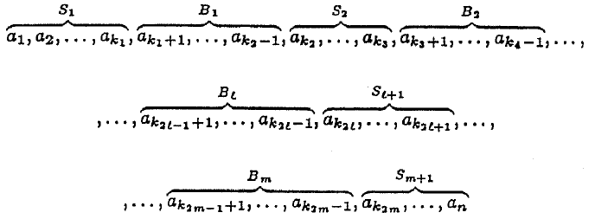
Proof
Lemma 1:
Proof: By applying GR to list L, it is subdivised into a sequence of sublists
Call the elements in S-lists small and in B-lists big
cost of the optimal solution
cost of the solution given by heuristic GR

Slide 9
Proof (cont.)
Candidate solution
Has exactly one big element and contains all small elements before this big element
Optimal solution
Has at least one big element
Let a_{t} be the big element with smallest index in the optimal solution and let Bq be the set containing a_{t}
Size of the items

Slide 10
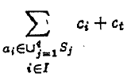
Proof (cont.)
J
K
J*
I
For all item a_{i}
with i <t , we have

Slide 11
Proof (cont.)
If
2. OPT (L)
J
K
J*
I

Slide 12
3/2 approximation greedy algorithm (IGR)
Define a new knapsack problem
1
Let and
Apply GR to L_{i} and M_{i} for all a_{i}
F
IGR cost is
B

Slide 13
Proof
Lemma 2:
Proof:
Investigate two case
cost of the optimal solution
cost of the solution given by heuristic IGR
We had
We Know
It results

Slide 14
Proof
Lemma 2:
Proof:
Investigate two case
cost of the optimal solution
cost of the solution given by heuristic IGR
We had
It results
Consider

Slide 15
Another Heuristic (GR*)
Consider as a candidate solution of GR
Let as small and as large items
Delete
If
Delete items until when we delete l
Candidate solution of GR* :
Cost of GR* is not more that cost of GR

Slide 16
Reference
J. Csirik, J. B. G. Frenk, M. Labbe, and S. Zhang. Heuristics for the 0-1 min-knapsack problem. Acta Cybernetica, 10(1-2):15-20, 1991.
Güntzer, Michael M., and Dieter Jungnickel. "Approximate minimization algorithms for the 0/1 knapsack and subset-sum problem." Operations Research Letters 26, no. 2 (2000): 55-66.

